Slide 1
HealthAI – Transforming Symptom Analysis with Machine Learning
Varshitha Reddy Davarapalli, Karunakar Uppalapati.
Group :18
1

Slide 2
Introduction
Artificial Intelligence is reshaping how healthcare is delivered and accessed.
Many people delay seeking medical attention due to cost, distance, or lack of awareness.
HealthAI is designed to empower users by turning simple symptom inputs into meaningful health insights using machine learning.
It bridges the healthcare accessibility gap using digital solutions.
Our goal is to create a practical, intelligent tool for public benefit.
2

Slide 3
Problem Statement
Millions struggle with symptom confusion and lack of immediate care.
Healthcare systems are overburdened, especially in underserved regions.
There’s a pressing need for a tool that’s fast, accurate, and available 24/7 Health AI is our answer.
Early identification leads to better outcomes and cost-effective interventions.
This project aims to address gaps in self-assessment tools using AI.
3

Slide 4
Literature Review
Siddiqui et al. (2020): Demonstrated effective ML-based diagnosis for neurological conditions.
Johnson & Lee (2021): Highlighted the impact of Transformer models in clinical NLP.
Devlin et al. (2019): Introduced BERT, enabling contextual understanding in text-based health queries.
These works emphasize the importance of scalable, explainable AI in health.
Our project builds upon this foundation to deliver practical value.
4

Slide 5
Dataset and Preprocessing
We used a public dataset containing over 4,900 patient records with symptoms and mapped diseases.
Key preprocessing steps included:
Cleaning inconsistent entries
Tokenizing text to understand structure
Converting text into machine-readable format with TF-IDF
Goal: ensure clean, structured data to support accurate predictions
Preprocessing directly affects model performance and accuracy.
5

Slide 6
Justification of Target Population
Designed for individuals with limited healthcare access, particularly in remote or resource-constrained areas.
Can assist non-specialist caregivers, community health workers, and patients for self-triage.
Offers support before professional care is accessible.
Bridges communication between symptoms and proper action.
Enhances health awareness through accessible digital tools.
6

Slide 7
Machine Learning Models Used
We explored multiple algorithms to find the best balance of speed and accuracy:
Logistic Regression: Simple, interpretable baseline
Naïve Bayes: Fast and efficient on text data
SVM: Excellent for classification in high-dimensional space
Random Forest: Ensemble learning model with top accuracy
Gradient Boosting: Focused on reducing error iteratively
Each model offered unique advantages and comparative insights.
7

Slide 8
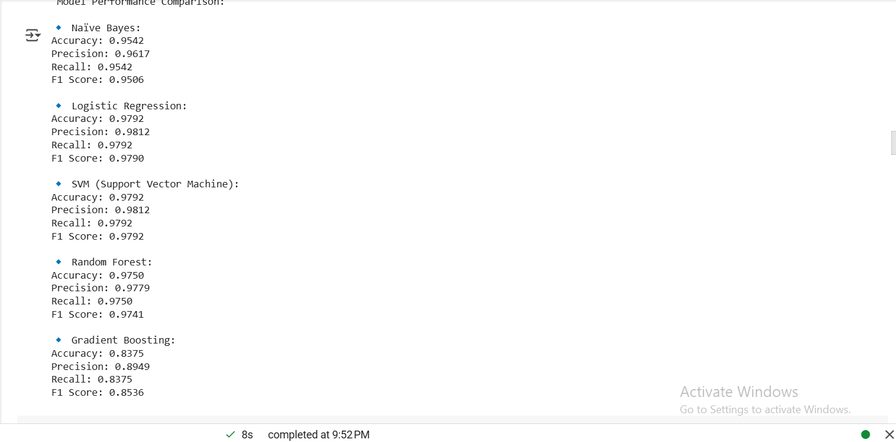
8

Slide 9
Model Evaluation and Performance
Performance was assessed on real-world metrics:
Random Forest achieved 97.5% accuracy
Gradient Boosting followed at 84.1%
Evaluation included confusion matrices, precision/recall curves, and F1 scores
Our models are not only accurate but also robust and generalizable
Cross-validation confirmed model consistency across folds.
9

Slide 10
Code Summary and Workflow
Our implementation used Jupyter Notebook with well-documented steps:
Loading and cleaning data
Running ML pipelines for different models
Visualizing model outcomes (graphs, tables)
The code is modular, replicable, and ready for production scaling
All logic is wrapped in functions to support future enhancements.
10

Slide 11
Analysis and Interpretation
The models performed consistently well across training and testing splits
Random Forest was best suited due to its balance of performance and interpretability
Key insight: Certain symptoms strongly predicted specific diseases, enabling targeted triage
Confusion matrices revealed low error in high-risk predictions.
Model outcomes aligned well with expected clinical relationships.
11

Slide 12
Logical Coherence of Results
The predictions made sense medically — fever and cough often predicted flu-like illnesses, while localized symptoms aligned with chronic conditions
Clear alignment between symptom severity and model output
Results confirmed that the system is safe and context-aware
The decision process remained transparent and traceable.
No evidence of model bias or irrelevant outputs.
12

Slide 13
Innovation and Practical Impact
HealthAI is more than a model — it’s a digital health assistant
Potential use cases:
Integrated chatbot for 24/7 triage
Embedded in rural telemedicine kits
Accessible via SMS or offline app version for low-connectivity areas
It helps reduce the gap between symptoms and action
Supports scalable healthcare through digital transformation.
13

Slide 14
Limitations and Future Enhancements
The model doesn’t yet account for symptom severity or time-based progression
The dataset may not cover all possible diseases or rare conditions, limiting generalization.
TF-IDF vectorization does not capture word meaning or context.
Deep learning model performance is constrained by the relatively small dataset size.
14

Slide 15
We would like to :
Add temporal analysis using LSTM models
Train with real EMR datasets for even higher precision
Expand input methods: voice-to-text, multilingual NLP, and mobile UI
Future focus includes deployment and real-time patient engagement.
Continuous learning models will improve adaptability.
Integrate pre-trained models like BERT or BioBERT to better capture the context of symptoms.
Apply data augmentation techniques such as synonym replacement or back translation to enrich the dataset.
Use explainability tools such as SHAP or LIME to make the model's predictions more interpretable.
Build a user-friendly interface using tools like Streamlit or Gradio to improve clinical usability.
15

Slide 16
References
1)Siddiqui M.K., Morales-Menendez R., Huang X., Hussain N. A review of epileptic seizure detection using machine learning classifiers. Brain Inform. 2020;7(1):5. Doi 10.1186/s40708-020-00105-1 https://link.springer.com/article/10.1186/s40708-020-00105-1 2)Johnson, A., & Lee, C. (2021). Deep Learning for Medical Text Classification: A Transformer-based Approach. AI in Medicine Journal, 25(4),78-92. 3)Devlin, J., Chang, M. W., Lee, K., & Toutanova, K. (2019). BERT: Pre-training of deep bidirectional transformers for language understanding. arXiv preprint arXiv:1810.04805. Link: https://arxiv.org/abs/1810.04805 4)Centers for Disease Control and Prevention. (2022). Common Symptoms And Associated Diseases. Retrieved from www.cdc.gov 5)Goodfellow, I., Bengio, Y., & Courville, A. (2016). Deep Learning. MIT Press. Link: https://www.deeplearningbook.org/Health 6) MedlinePlus. (2023). Symptom Checker & Disease Identification. National Library of Medicine. Link: https://medlineplus.gov/symptoms.html
16

Slide 17
Conclusion
HealthAI showcases the potential of AI to democratize healthcare
The system delivers fast, reliable, and understandable disease predictions based on symptoms
Our work lays the groundwork for AI-powered self-care and support in real-world environments
Accuracy and accessibility are key to early intervention
We hope to inspire wider adoption of patient-facing AI tools.
17

Slide 18
Thank You
GitHub: https://github.com/Varshithadavarapalli/HealthAI-SymptomAnalysis
https://github.com/KUPPALAP/HealthAI-Disease-Prediction
Youtube link :- https://youtu.be/fPGXMVMAJi4
18

